Slide 1

Library Management System
Teemara Sai

Slide 2
About me
Name : TEEMARA SAI
Background : B.Tech (Computer Science & Engineering)
Linkedin : https://www.linkedin.com/in/sai-teemara-8b04ab258/
Github : github.com/saiteemara

Slide 3
Agenda (This should be the PPT flow)
Objective of the Project
ER Diagram and schema explanation
Key analysis questions (use cases)
SQL query results with screenshots or summaries
Final business insights and recommendations
Conclusion (Key finding overall)
Q&A Slide
Your Experience/Challenges working on SQL – Data Analysis Project.

Slide 4
PROJECT OBJECTIVE
Project Goal :
  The project's main goal is to design and analyze a relational database for a library. This involves using SQL to structure the data, ensure its integrity, and answer key business questions.
Key Objectives:
  Database Design: Create a logical database schema by defining tables, columns, and relationships.
  Data Integrity: Use primary and foreign keys to enforce relationships and ensure data consistency.
  SQL Querying: Write complex queries to retrieve meaningful information, such as book availability and borrower activity.
  Problem-Solving: Translate real-world business questions into effective SQL queries to provide actionable insights.

Slide 5
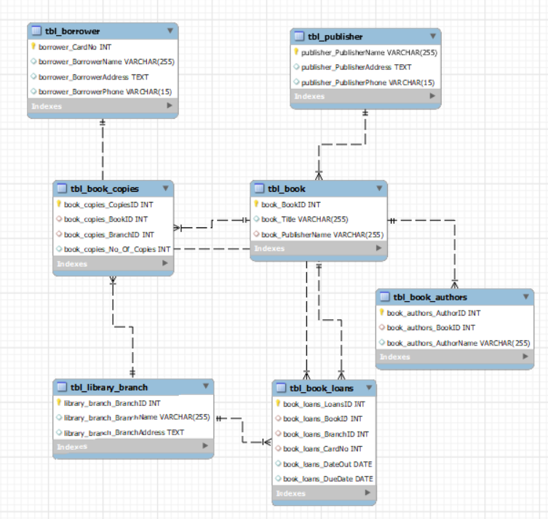
ER Diagram and schema explanation

Slide 6
SCHEMA EXPLAINATION
This schema models a library management system, tracking books, authors, branches, borrowers, loans, publishers, and copies.
Key Entities:
  tbl_book: Stores book details (BookID, Title, PublisherName).
  tbl_book_authors: Links books to their authors.
  tbl_publisher: Contains publisher contact information.
  tbl_library_branch: Lists all library branches.
  tbl_borrower: Stores borrower details such as name and contact.
  tbl_book_copies: Tracks the number of copies of each book in each branch.
  tbl_book_loans: Records when a borrower loans a book from a specific branch.

Slide 7
RELATIONSHIPS AND DATAFLOW
Relationships:
  Book–Publisher: Each book is published by one publisher.
  Book–Author: A book can have multiple authors (many-to-one via tbl_book_authors).
  Book–Branch: tbl_book_copies links books to branches with quantity.
  Borrower–Loan: Borrowers loan books via tbl_book_loans.
  Loan–Book/Branch: Each loan references a book and the branch it's borrowed from.
Data Flow Example:
  Borrower → Loans Book (from Branch) → Book Copy → Book Info → Author & Publisher

Slide 8
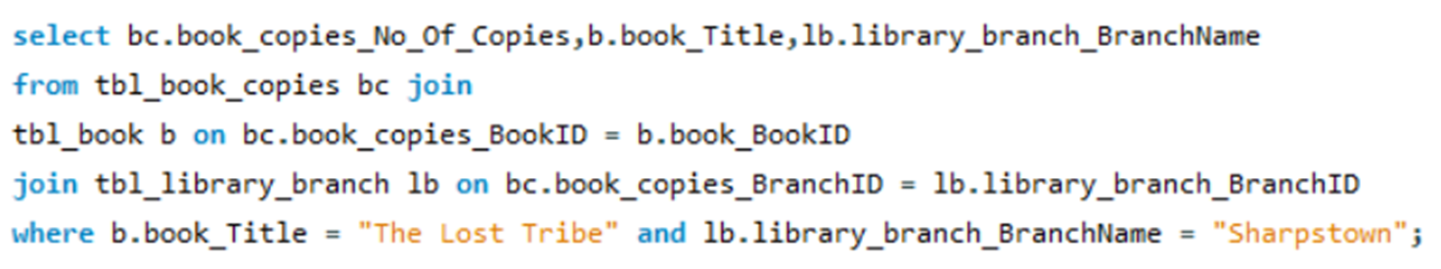
Book Copies at Sharpstown Branch
Objective: Find how many copies of The Lost Tribe are available at the Sharpstown branch.
Method: Used SQL JOIN queries to link Books, Book Copies, and Library Branch tables.
Condition: Filtered records where
  book_Title = 'The Lost Tribe’
  library_branch_BranchName = 'Sharpstown'.
Copies of "The Lost Tribe" in Sharpstown: Shows how many copies of the book titled "The Lost Tribe" are available specifically in the Sharpstown branch.

Slide 9
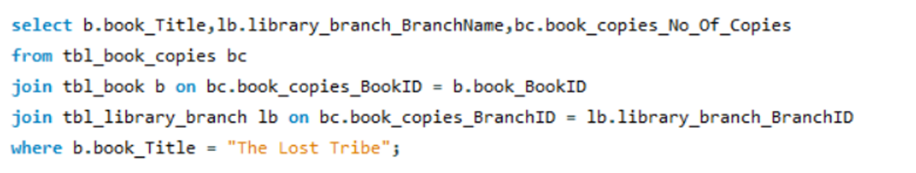
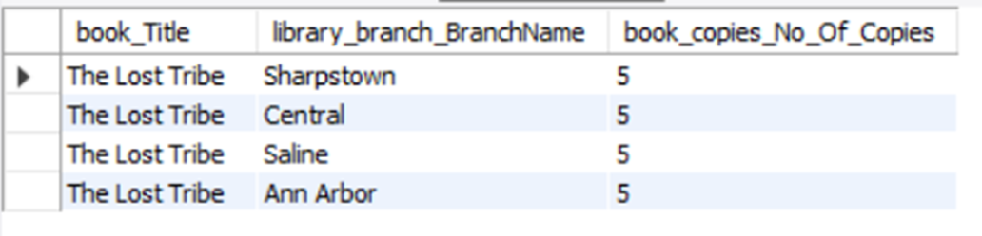
Copies of "The Lost Tribe" in Each Branch
Objective: How many copies of the book titled "The Lost Tribe" are owned by each library branch?
Method:
  Joined Books, Book Copies, and Library Branch tables.
  Filtered for book_Title = 'The Lost Tribe'.
Insight: The book The Lost Tribe is evenly distributed, with 5 copies in each branch, ensuring equal availability across the library system.

Slide 10
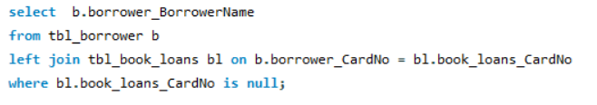
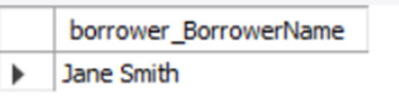
Borrowers with No Books Checked Out
Objective: Retrieve the names of all borrowers who do not have any books checked out.
Method:
  Queried the Borrower table.
  Used a NOT EXISTS subquery to check if the borrower’s CardNo is absent in the Book Loans table.
Insight: Identifying inactive borrowers helps the library understand user engagement levels and design strategies (like reminders or reading programs) to encourage more borrowing.

Slide 11
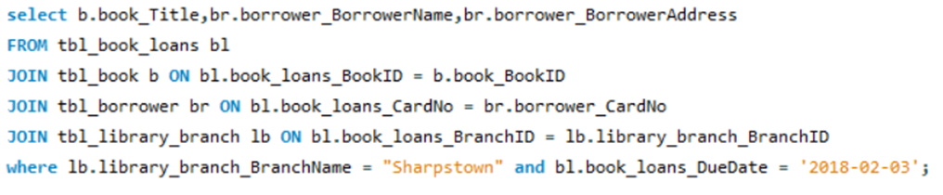
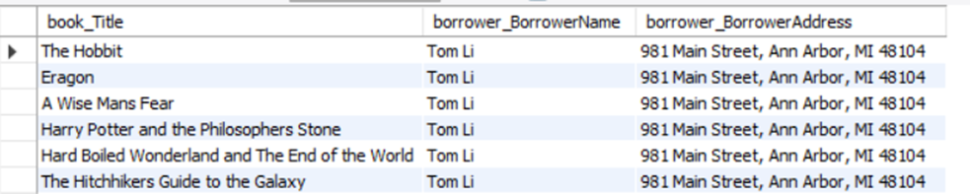
Loans from Sharpstown Branch (Due: 2/3/18)
Objective: For each book that is loaned out from the "Sharpstown" branch and whose DueDate is 2/3/18, retrieve the book title, the borrower's name, and the borrower's address.
Method:
  Joined Book Loans, Books, Borrowers, and Library Branch tables.
  Applied conditions:
    library_branch_BranchName = 'Sharpstown’
    book_loans_DueDate = '2018-02-03'
Insight: This query helps track who borrowed which book and where to send reminders/notices when the book’s due date arrives.
Books Loaned from Sharpstown Due on 2018-02-03: Lists all books that were checked out from the Sharpstown branch and are scheduled to be returned on February 3, 2018.

Slide 12
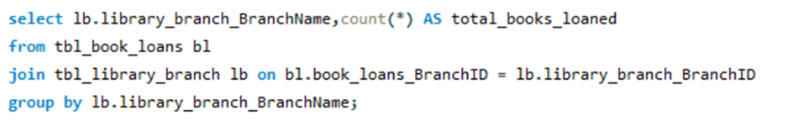
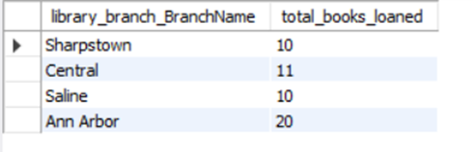
Total Books Loaned by Each Branch
Objective: For each library branch, retrieve the branch name and the total number of books loaned out from that branch.
Method:
  Joined Book Loans with Library Branch table.
  Used COUNT(*) to calculate the total number of loans per branch.
  Grouped results by library_branch_BranchName.
Insight: This shows which branches are more active in lending, helping the library in resource allocation, staff planning, and understanding member demand per branch.

Slide 13
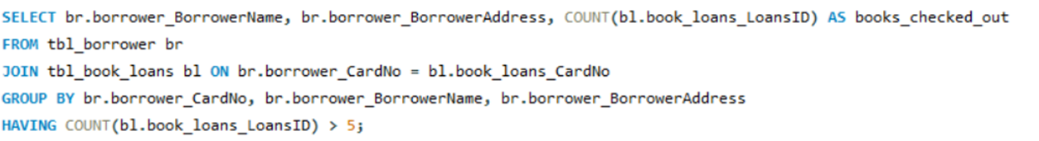
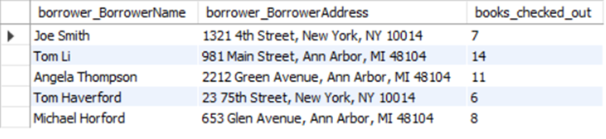
Borrowers with More Than Five Books Checked Out
Objective: Retrieve the names, addresses, and number of books currently checked out for all borrowers who have more than five books loaned.
Method:
  Joined Borrowers (tbl_borrower) and Book Loans (tbl_book_loans) tables using borrower_CardNo.
  Counted the number of books each borrower has checked out using COUNT(book_loans_LoansID).
Insight: This query helps identify borrowers with high book usage, which can be used for monitoring frequent borrowers, sending reminders, or managing library resources efficiently.

Slide 14
Final business insights and recommendations
Optimize Book Availability - Add more copies of high-demand books and reallocate underused ones across branches.
Boost Borrower Engagement - Reduce overdue loans with reminders/penalties and encourage inactive borrowers through campaigns.
Improve Branch Performance - Support low-activity branches with events, promotions, and better resource allocation.

Slide 15
CHALLENGES WHILE WORKING
Database Design Issues
  Ensuring correct table relationships (foreign keys & constraints).
  Handling normalization while avoiding redundancy.
Data Import & Cleaning
  Matching column names with CSV files.
  Managing inconsistent/missing values during import
SQL Query Complexity
  Writing JOIN queries across multiple tables.
  Handling date conditions (e.g., due dates, loans).
Debugging & Errors
  Syntax errors in queries.
  Resolving constraint violations while inserting records.

Slide 16
Conclusion
The library analysis highlights how data-driven insights can improve book circulation, borrower engagement, and branch efficiency. By addressing overdue loans, optimizing book distribution, and promoting underused branches, the library can enhance both user satisfaction and operational performance.

Slide 17

THANK YOU

